Slide 1

Das Digitale Langzeitarchiv an der Universitätsbibliothek Basel
Strategie & Vision
Jürgen Enge
juergen.enge@unibas.ch

Slide 2
TRUST Principles
Principle | Guidance for repositories
Transparency | To be transparent about specific repository services and data holdings that are verifiable by publicly accessible evidence.
Responsibility | To be responsible for ensuring the authenticity and integrity of data holdings and for the reliability and persistence of its service.
User Focus | To ensure that the data management norms and expectations of target user communities are met.
Sustainability | To sustain services and preserve data holdings for the long-term.
Technology | To provide infrastructure and capabilities to support secure, persistent, and reliable services.
Lin, D., Crabtree, J., Dillo, I. et al. The TRUST Principles for digital repositories. Sci Data 7, 144 (2020). https://doi.org/10.1038/s41597-020-0486-7

Slide 3
Interpretation in Bezug auf Technologie
Transparenz: Sämtliche Prozesse sind einfach verständlich und kommunizierbar
Verantwortung: Dies ist nur möglich, wenn es ein vollständiges Verständnis über die Ablage der Inhalte gibt
BenutzerInnenzentriertheit: Das System darf nicht zu wenig und nicht zu viel können.
Nachhaltigkeit: Gut definierte (Meta-)Datenstrukturen im Archiv unterstützen die Nachhaltigkeit
Technologie: Durch technologischen Wandel dürfen die obigen Punkte nicht tangiert werden.

Slide 4
Merkmale
Unabhängigkeit
Nachhaltigkeit
Speicherort
AIP-Struktur
Archiv-management-system
Speicherung

Slide 5
Folgerung
Unabhängigkeit
Nachhaltigkeit
Cloud (public/private)
S3 Speicher/…
OCFL
Microservices
Automatisierte Verteilung

Slide 6

OCFL
Oxford Common File Layout
This Oxford Common File Layout (OCFL) specification describes an application-independent approach to the storage of digital information in a structured, transparent, and predictable manner. It is designed to promote long-term object management best practices within digital repositories.
Specifically, the benefits of the OCFL include:
Completeness, so that a repository can be rebuilt from the files it stores
Parsability, both by humans and machines, to ensure content can be understood in the absence of original software
Robustness against errors, corruption, and migration between storage technologies
Versioning, so repositories can make changes to objects allowing their history to persist
Storage diversity, to ensure content can be stored on diverse storage infrastructures including conventional filesystems and cloud object stores
https://ocfl.io/1.1/spec/

Slide 7
OCFL
Neue Möglichkeiten für Formatmigrationen
Oxford Common File Layout
This Oxford Common File Layout (OCFL) specification describes an application-independent approach to the storage of digital information in a structured, transparent, and predictable manner. It is designed to promote long-term object management best practices within digital repositories.
Specifically, the benefits of the OCFL include:
Completeness, so that a repository can be rebuilt from the files it stores
Parsability, both by humans and machines, to ensure content can be understood in the absence of original software
Robustness against errors, corruption, and migration between storage technologies
Versioning, so repositories can make changes to objects allowing their history to persist
Storage diversity, to ensure content can be stored on diverse storage infrastructures including conventional filesystems and cloud object stores
https://ocfl.io/1.1/spec/

Slide 8
OCFL
Gleichberechtigte Speicherung an vielen Orten
Oxford Common File Layout
This Oxford Common File Layout (OCFL) specification describes an application-independent approach to the storage of digital information in a structured, transparent, and predictable manner. It is designed to promote long-term object management best practices within digital repositories.
Specifically, the benefits of the OCFL include:
Completeness, so that a repository can be rebuilt from the files it stores
Parsability, both by humans and machines, to ensure content can be understood in the absence of original software
Robustness against errors, corruption, and migration between storage technologies
Versioning, so repositories can make changes to objects allowing their history to persist
Storage diversity, to ensure content can be stored on diverse storage infrastructures including conventional filesystems and cloud object stores
https://ocfl.io/1.1/spec/

Slide 9
OCFL
Source of Truth
Aufbau des Systems aus den Archivalien heraus
Oxford Common File Layout
This Oxford Common File Layout (OCFL) specification describes an application-independent approach to the storage of digital information in a structured, transparent, and predictable manner. It is designed to promote long-term object management best practices within digital repositories.
Specifically, the benefits of the OCFL include:
Completeness, so that a repository can be rebuilt from the files it stores
Parsability, both by humans and machines, to ensure content can be understood in the absence of original software
Robustness against errors, corruption, and migration between storage technologies
Versioning, so repositories can make changes to objects allowing their history to persist
Storage diversity, to ensure content can be stored on diverse storage infrastructures including conventional filesystems and cloud object stores
https://ocfl.io/1.1/spec/

Slide 10



OCFL
Source of Truth
Aufbau des Systems aus den Archivalien heraus
Revisionssicherheit
Metadaten
Medien

Slide 11
OCFL
Revisionssicherheit
gocfl
Formaterkennung
Migration
Paketierung
Validierung
Metadaten
Medien

Slide 12
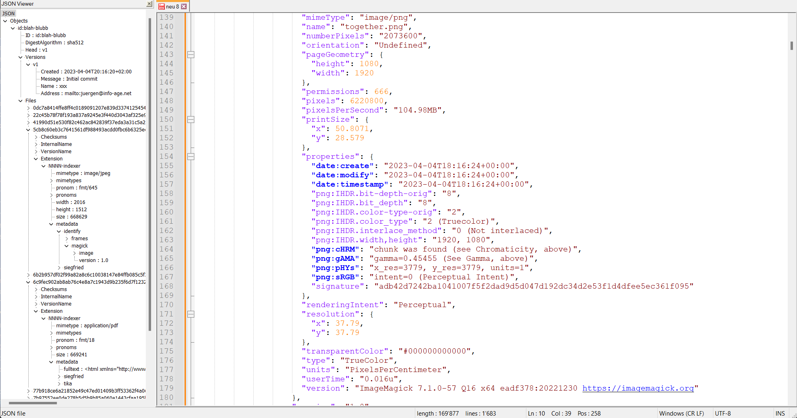
gocfl - tech. Metadaten
Revisionssicherheit
gocfl
Formaterkennung
Migration
Paketierung
Validierung
Metadaten
Metadaten
Medien
Medien

Slide 13
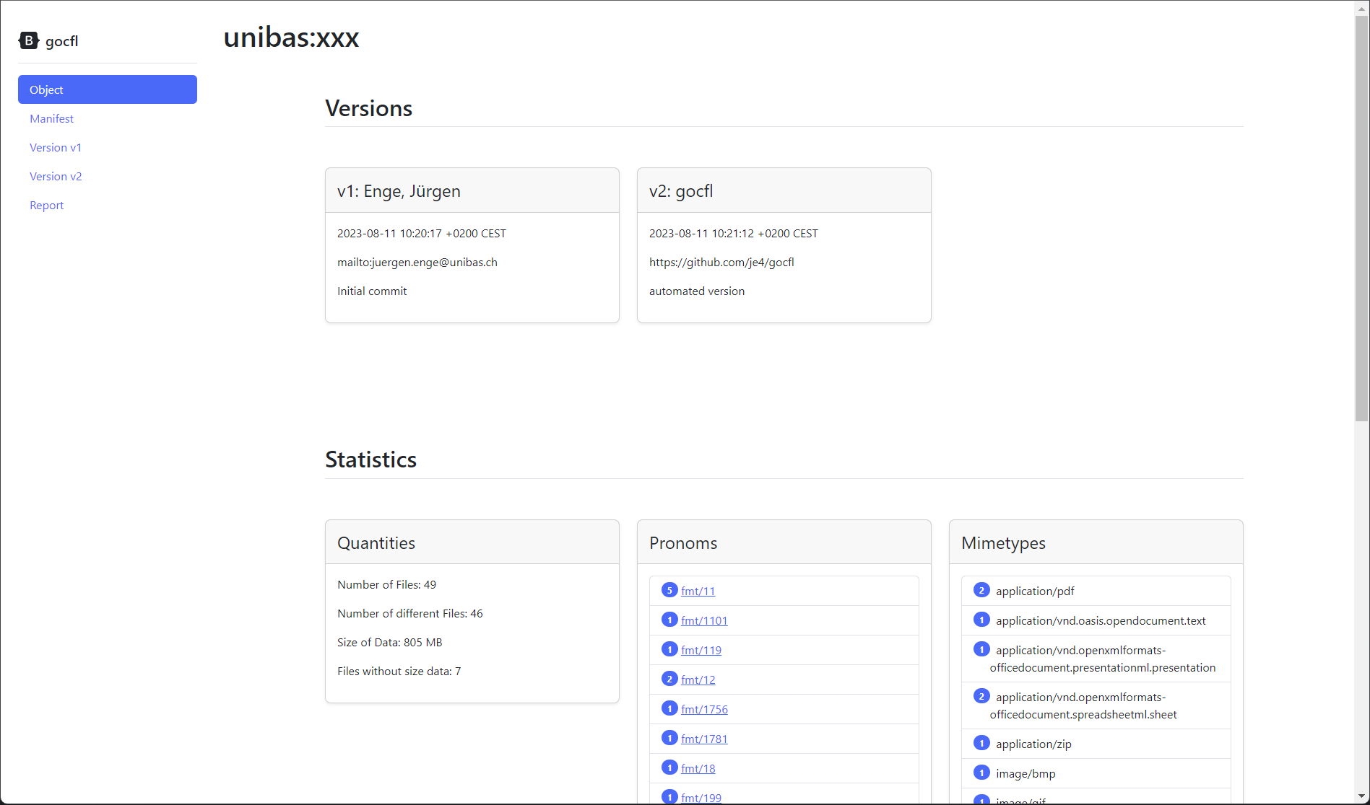
gocfl – Reporting (Webbrowser)

Slide 14
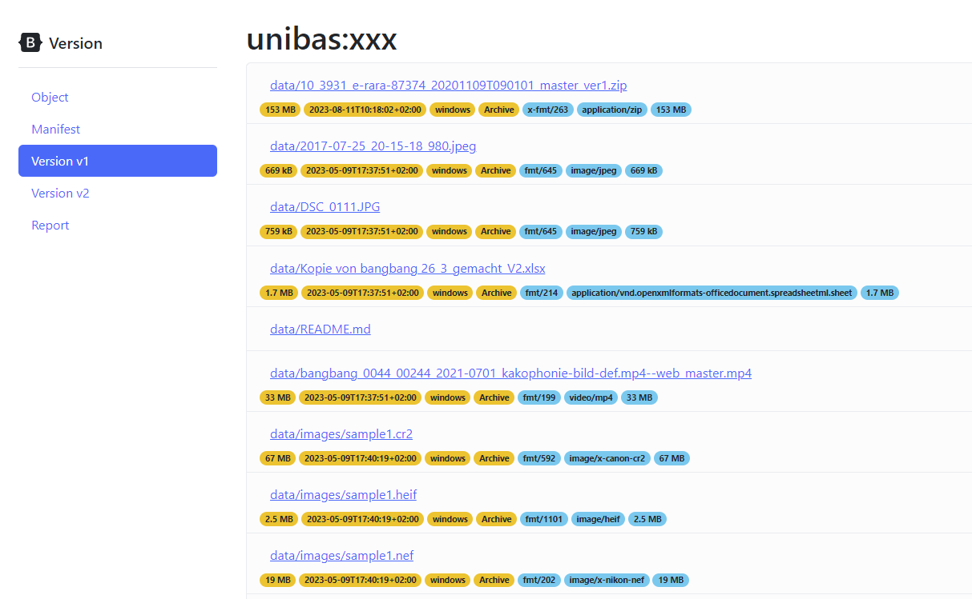
gocfl – Reporting (Webbrowser)

Slide 15
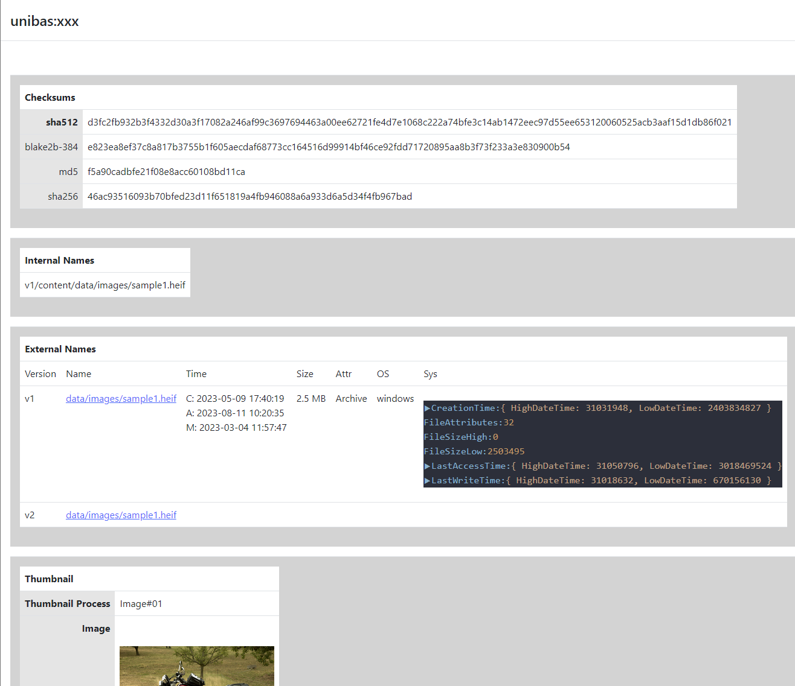
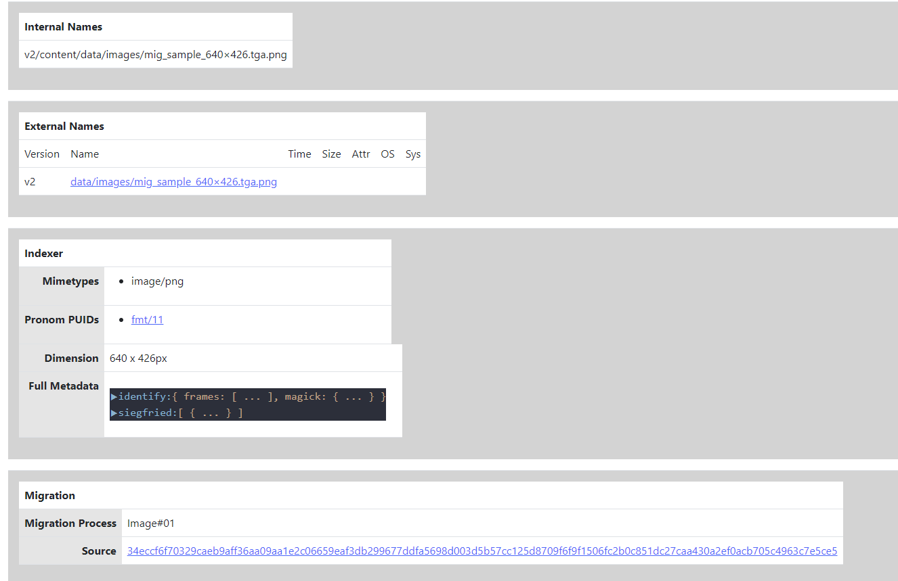
gocfl – Reporting (Webbrowser)

Slide 16
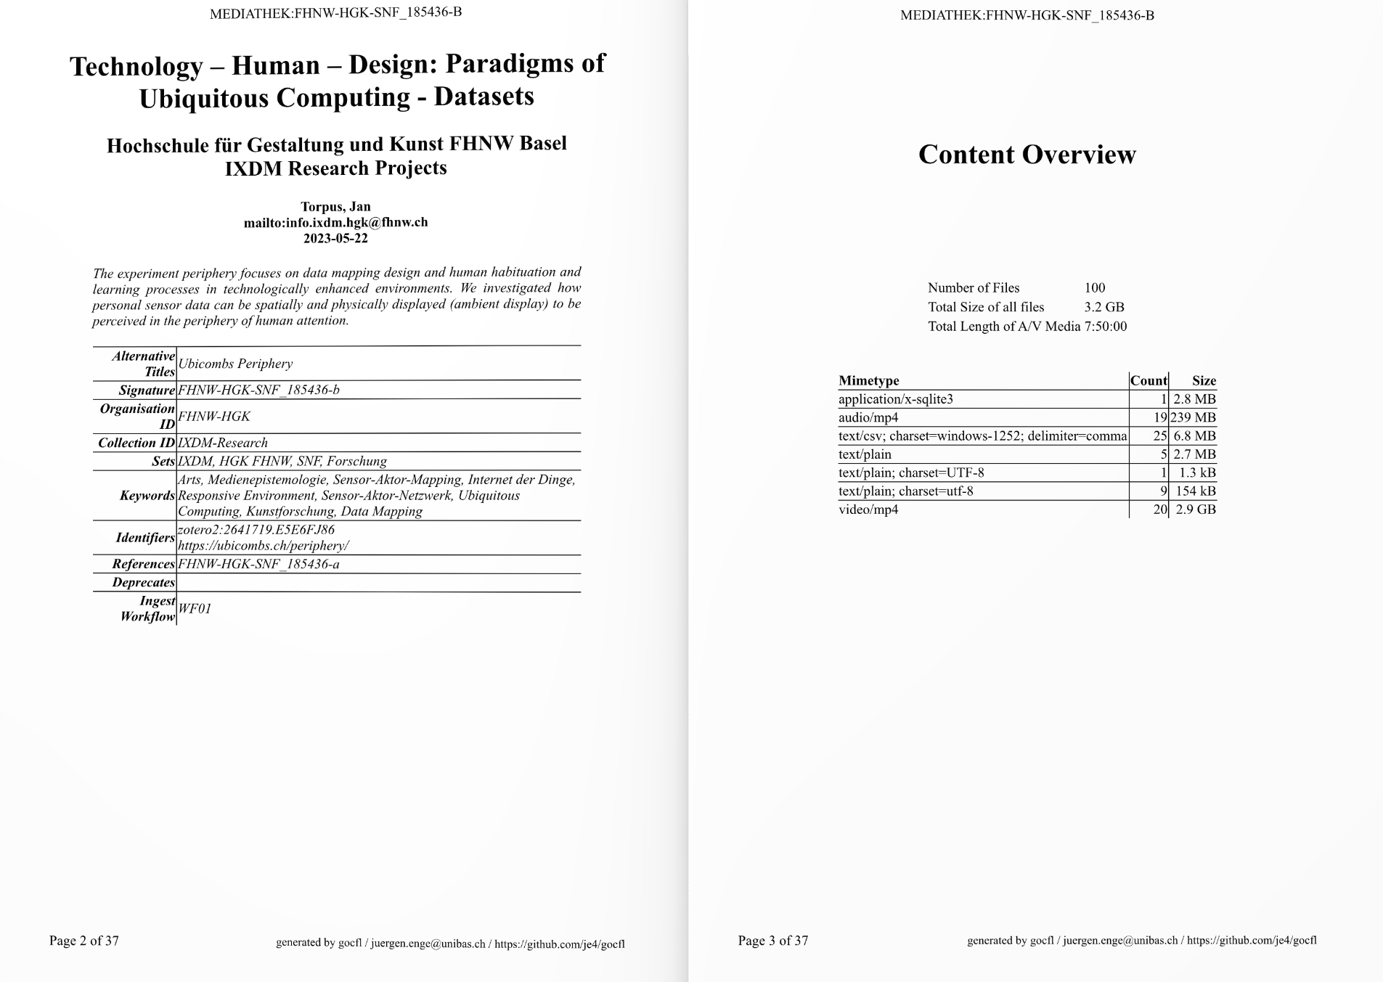
gocfl – Reporting (PDF)
https://doi.org/10.26254/med/6352

Slide 17
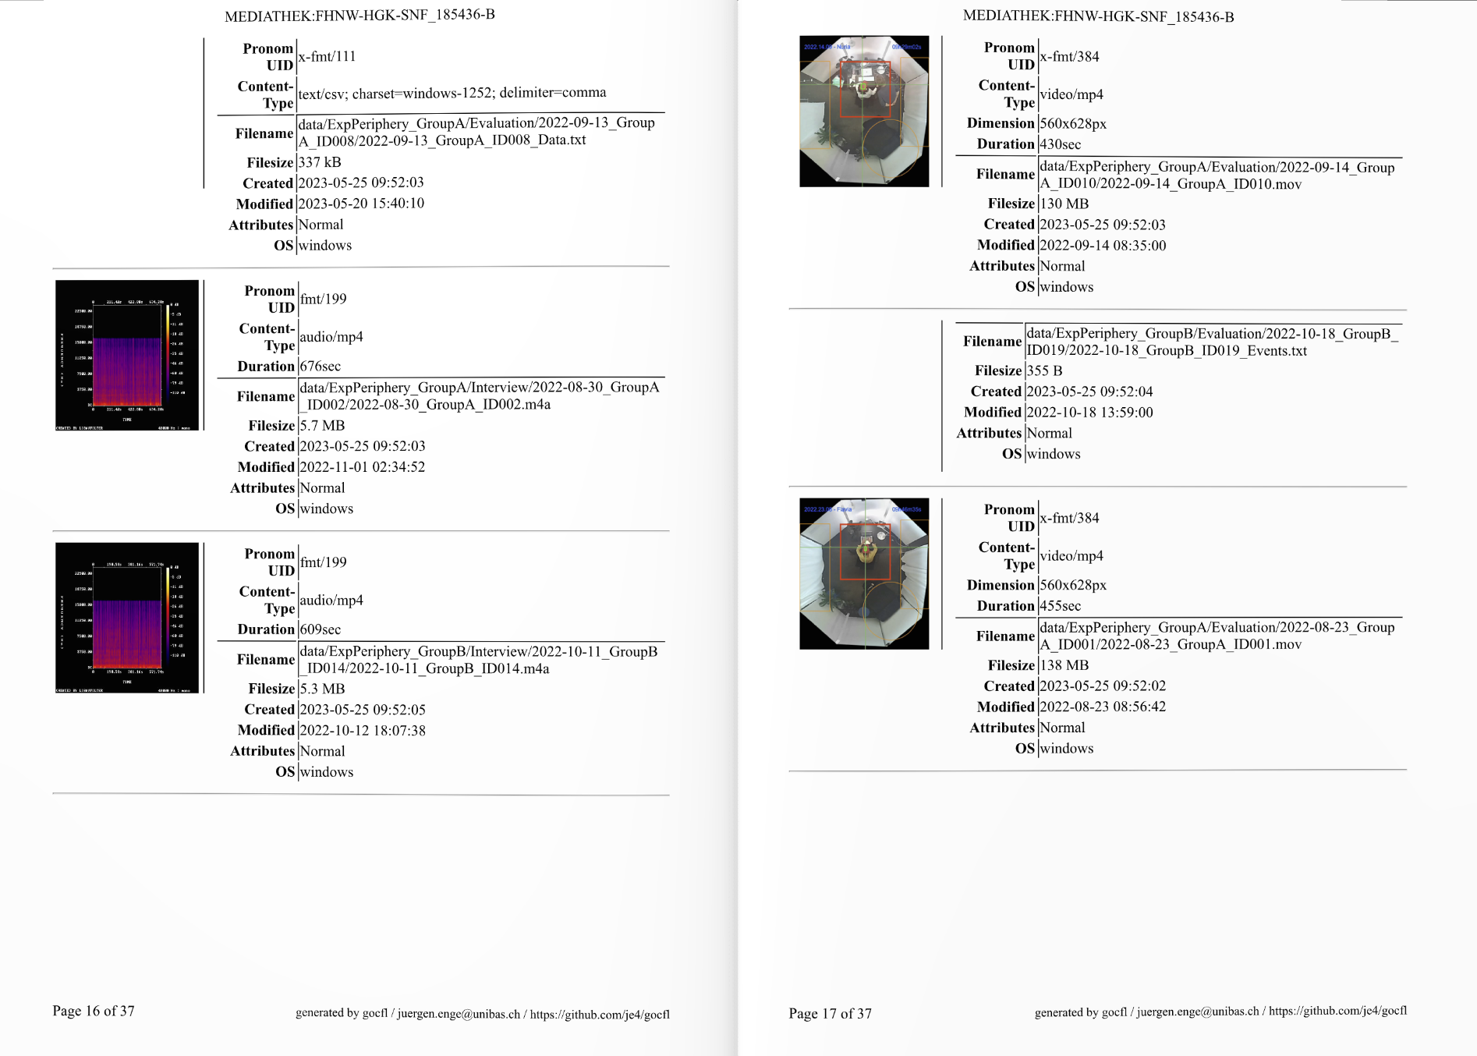
gocfl – Reporting (PDF)
https://doi.org/10.26254/med/6352

Slide 18





DLZA UB
Archival Storage System
Reporter
Mapper
Unibas sciCore (S3)
Unibas sciCore (S3)
Digispace
Ingester
SIP Builder
gocfl
Formaterkennung
Migration
Mediaserver
SWITCHcoldstor
(S3)
Paketierung
SWITCHcoldstor
Lausanne (S3)
Validierung
Archival
Manager
Indexer
Checker
UB Disk Storage
SWITCHcoldstor
Zürich (S3)
Dispatcher
Medien

Slide 19
DLZA UB
Archival Storage System
Trennung von Speicherung und Management
Speicherprovider unabhängig von Archivmanagementsystem
Archivmanagement als Microservice Architektur
Mandantenfähig
Idee
Zentraler Betrieb des Archivmanagements
Dezentrale Speicherung basierend auf gewünschter Qualität und Kosten
Reporter
Unibas sciCore (S3)
Unibas sciCore (S3)
Ingester
gocfl
Formaterkennung
Migration
SWITCHcoldstor
(S3)
Paketierung
SWITCHcoldstor
Lausanne (S3)
Validierung
Archival
Manager
Checker
UB Disk Storage
SWITCHcoldstor
Zürich (S3)
Dispatcher
Medien

Slide 20
Vielen Dank für die Aufmerksamkeit
Jürgen Enge
juergen.enge@unibas.ch

